Slide 1
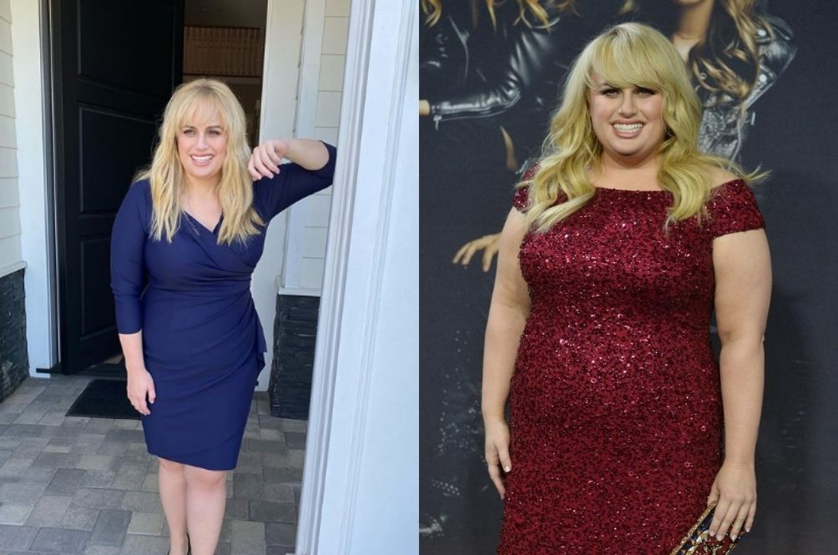
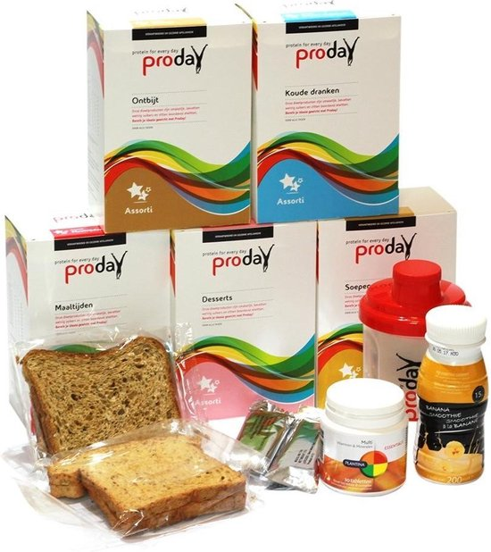
Proday
Rebel Wilson

Slide 2
Rebel wilson
Actrice
Fat Amy in pitch perfect
Streefgewicht
Minder koolhydraten meer proteïnen
Proteinen dieet

Slide 3
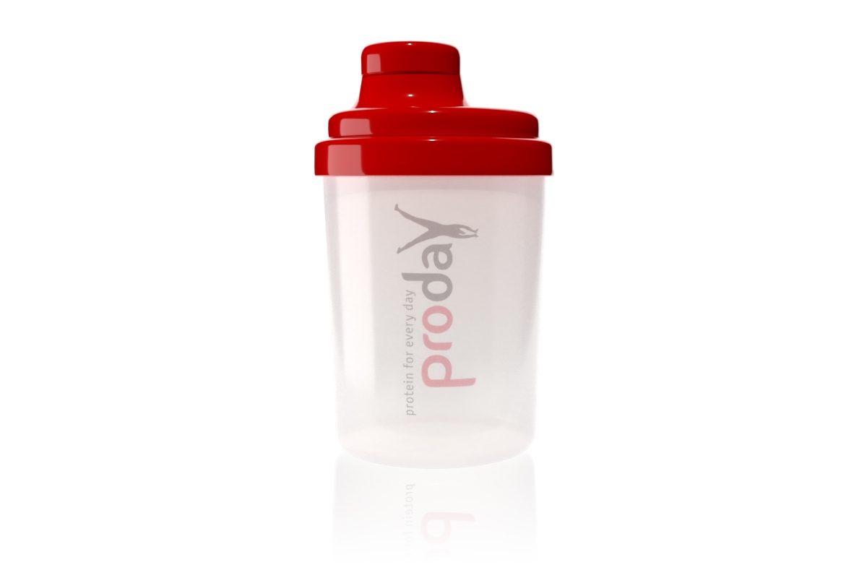
Proday
Proday: protein for every day!“

